Slide 1

Citibike: Role in NY Commute
James Dietz
NOTE: I ended up using screenshots and PP because the 9 million records were too much for Tableau. I had storyboards and dashboards that captioned my analysis but that was lost completely.

Slide 2
In Brief
Citibike appears to serve a niche role in short duration/distance trips that complement existing modes of NY transportation and its commuting patterns.
The analysis demonstrates that heavy usage stations and most frequent Citibike trips tend to be tied to high traffic, high income, high density areas.
In addition, these high frequency use patterns seem to be tied to major north south thoroughfares, major entry ways (bridges, tunnels, Penn Station and Grand Central commuter railway stations) to Manhattan, and subway stations.

Slide 3
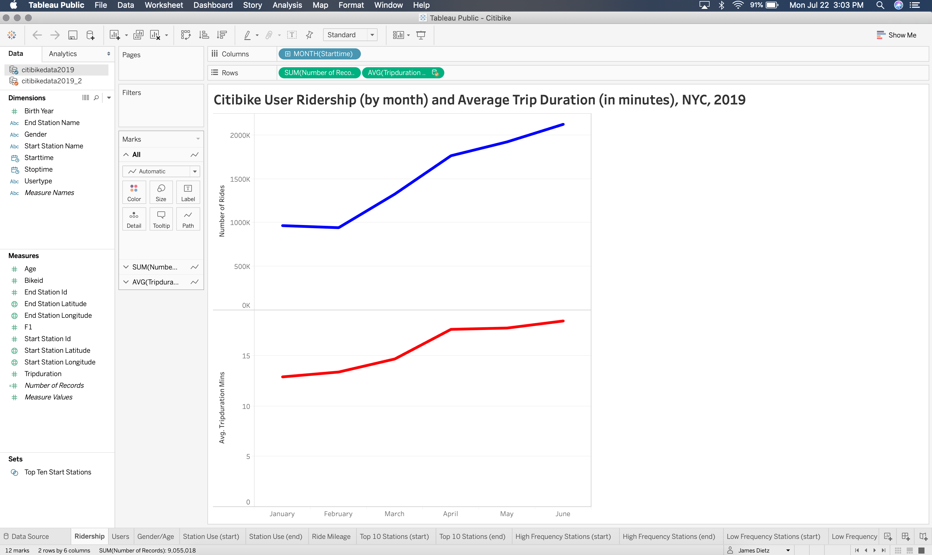

Slide 4
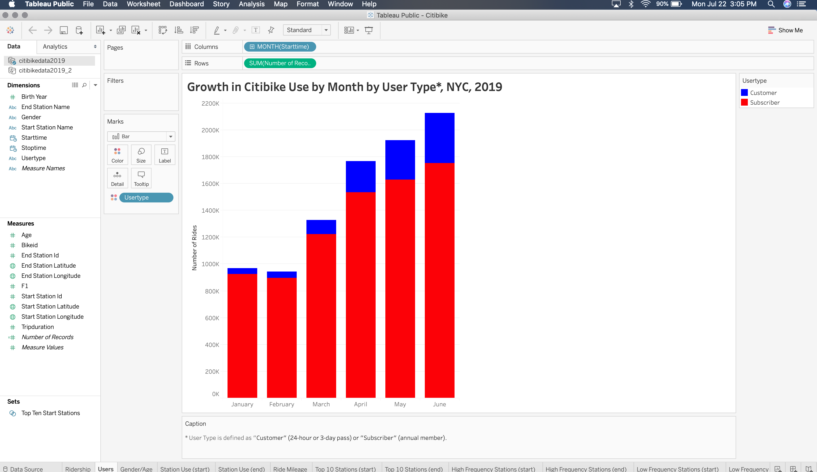

Slide 5
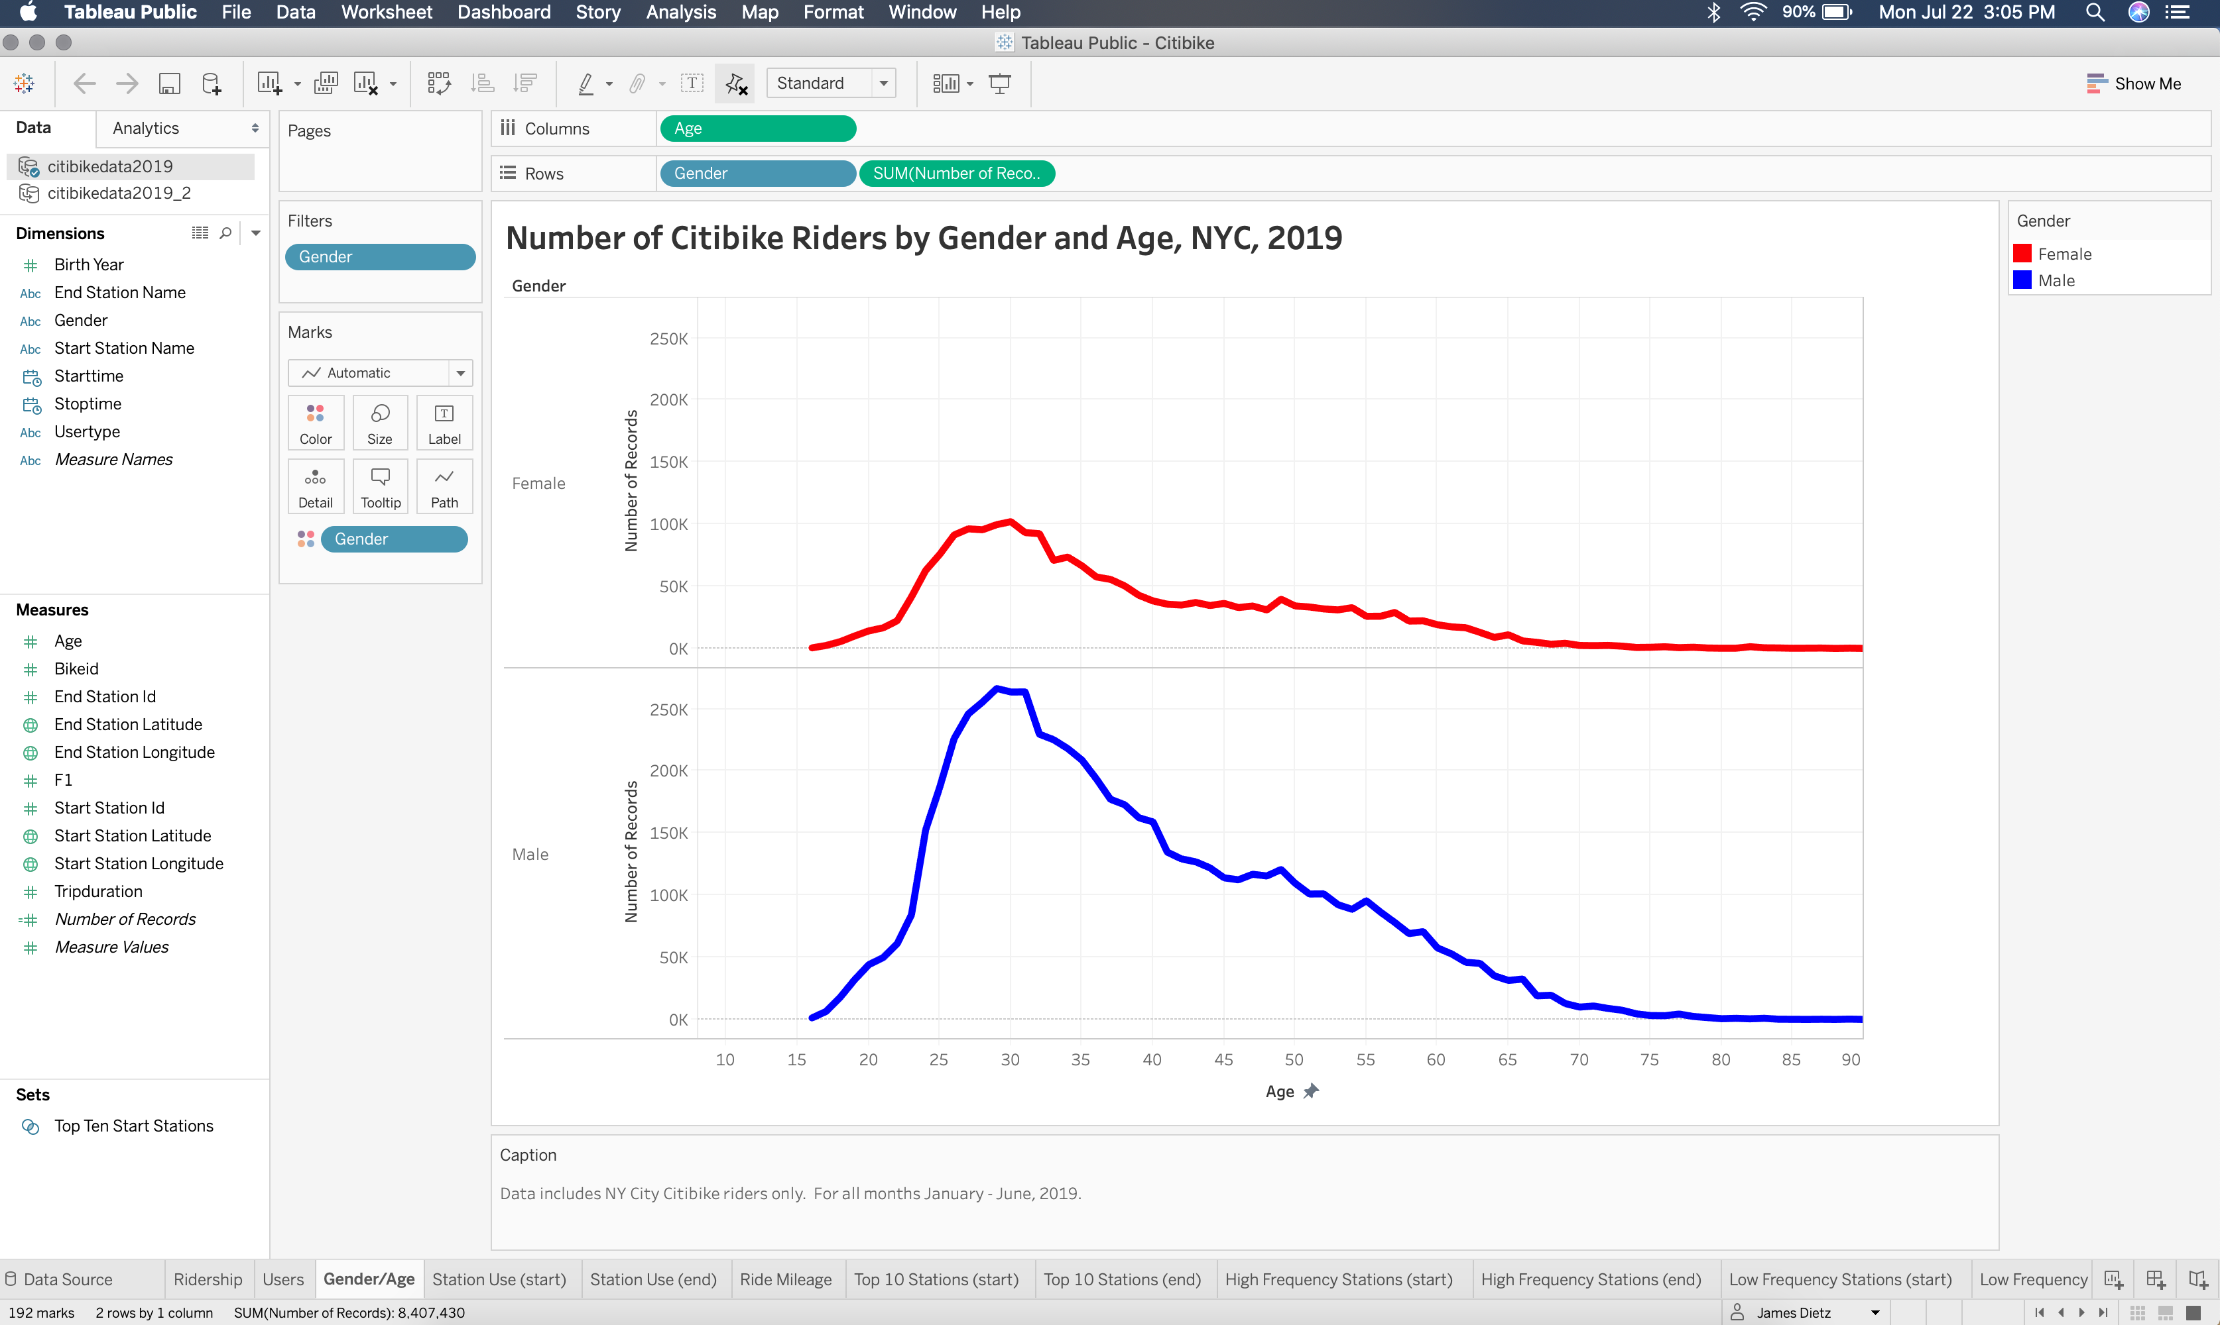

Slide 6
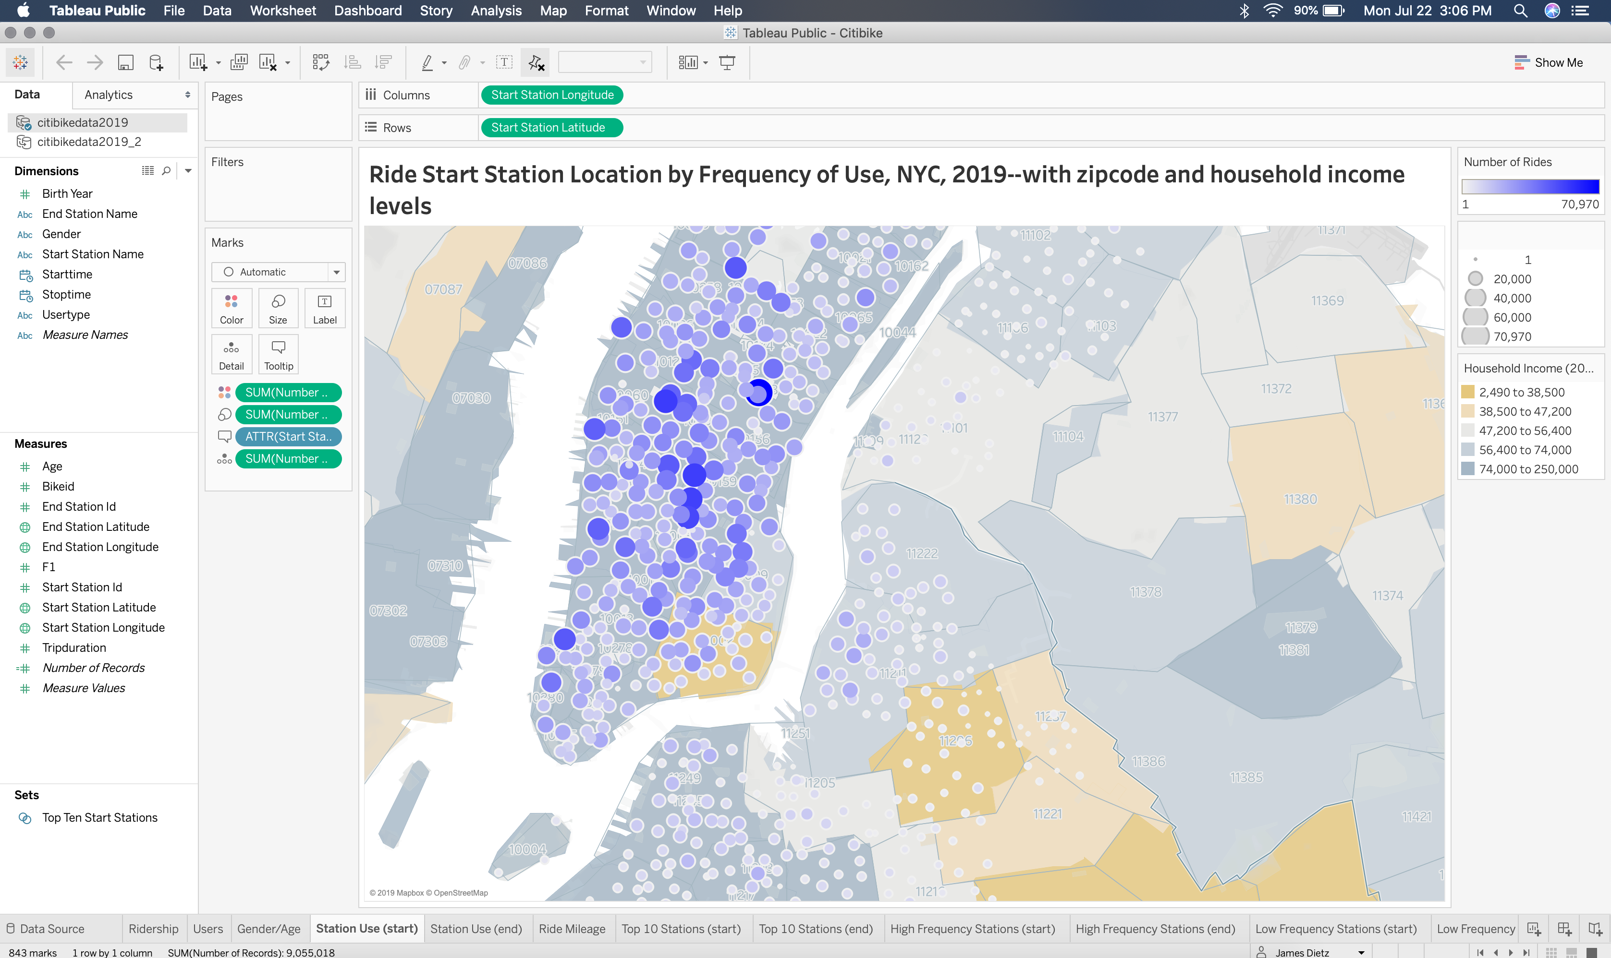

Slide 7
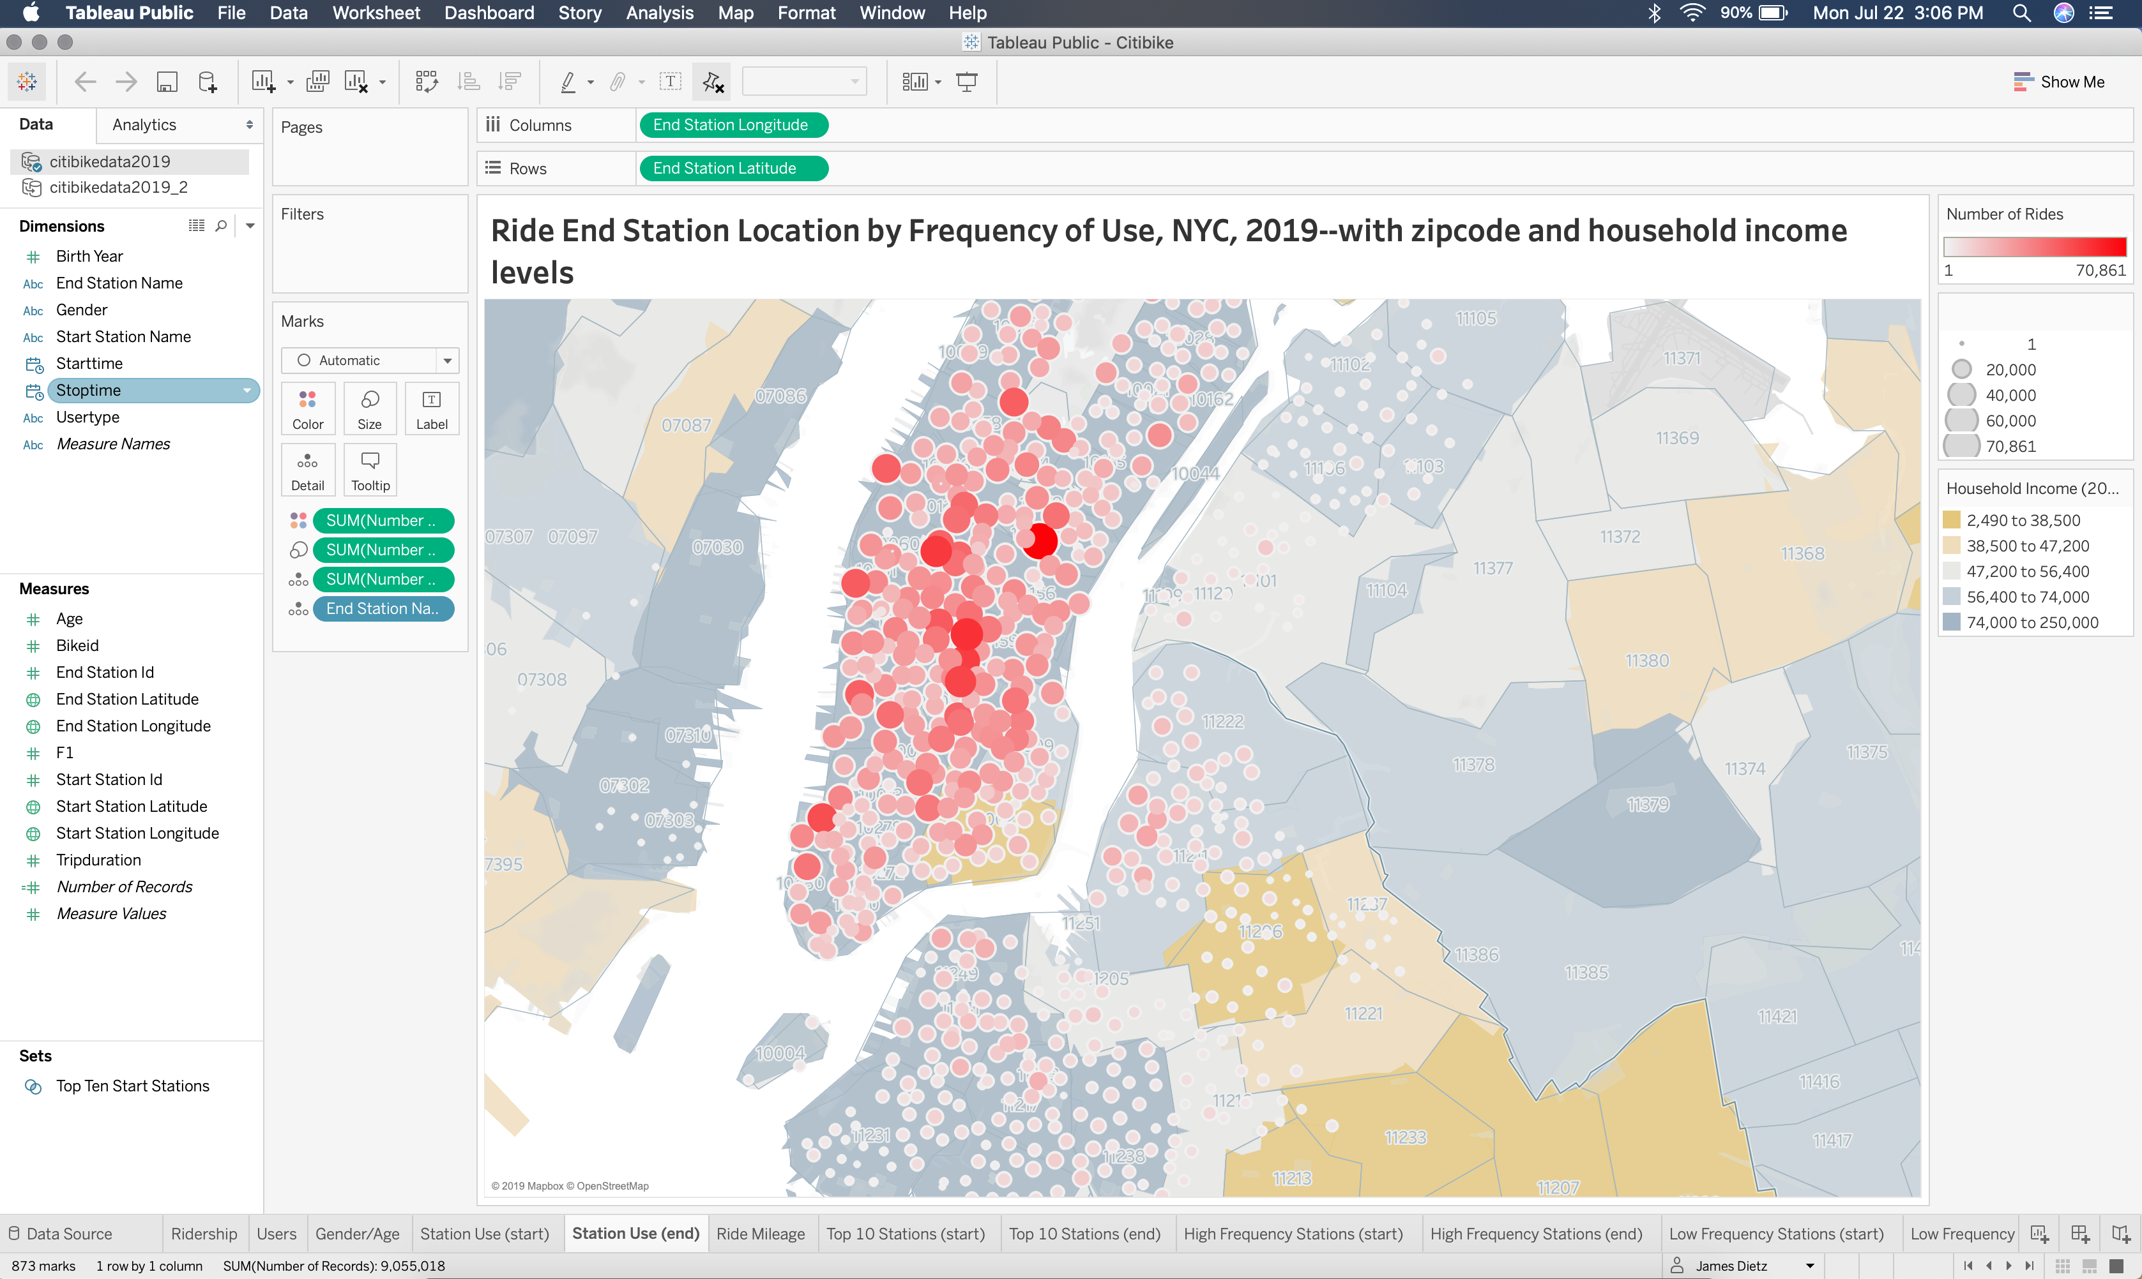

Slide 8
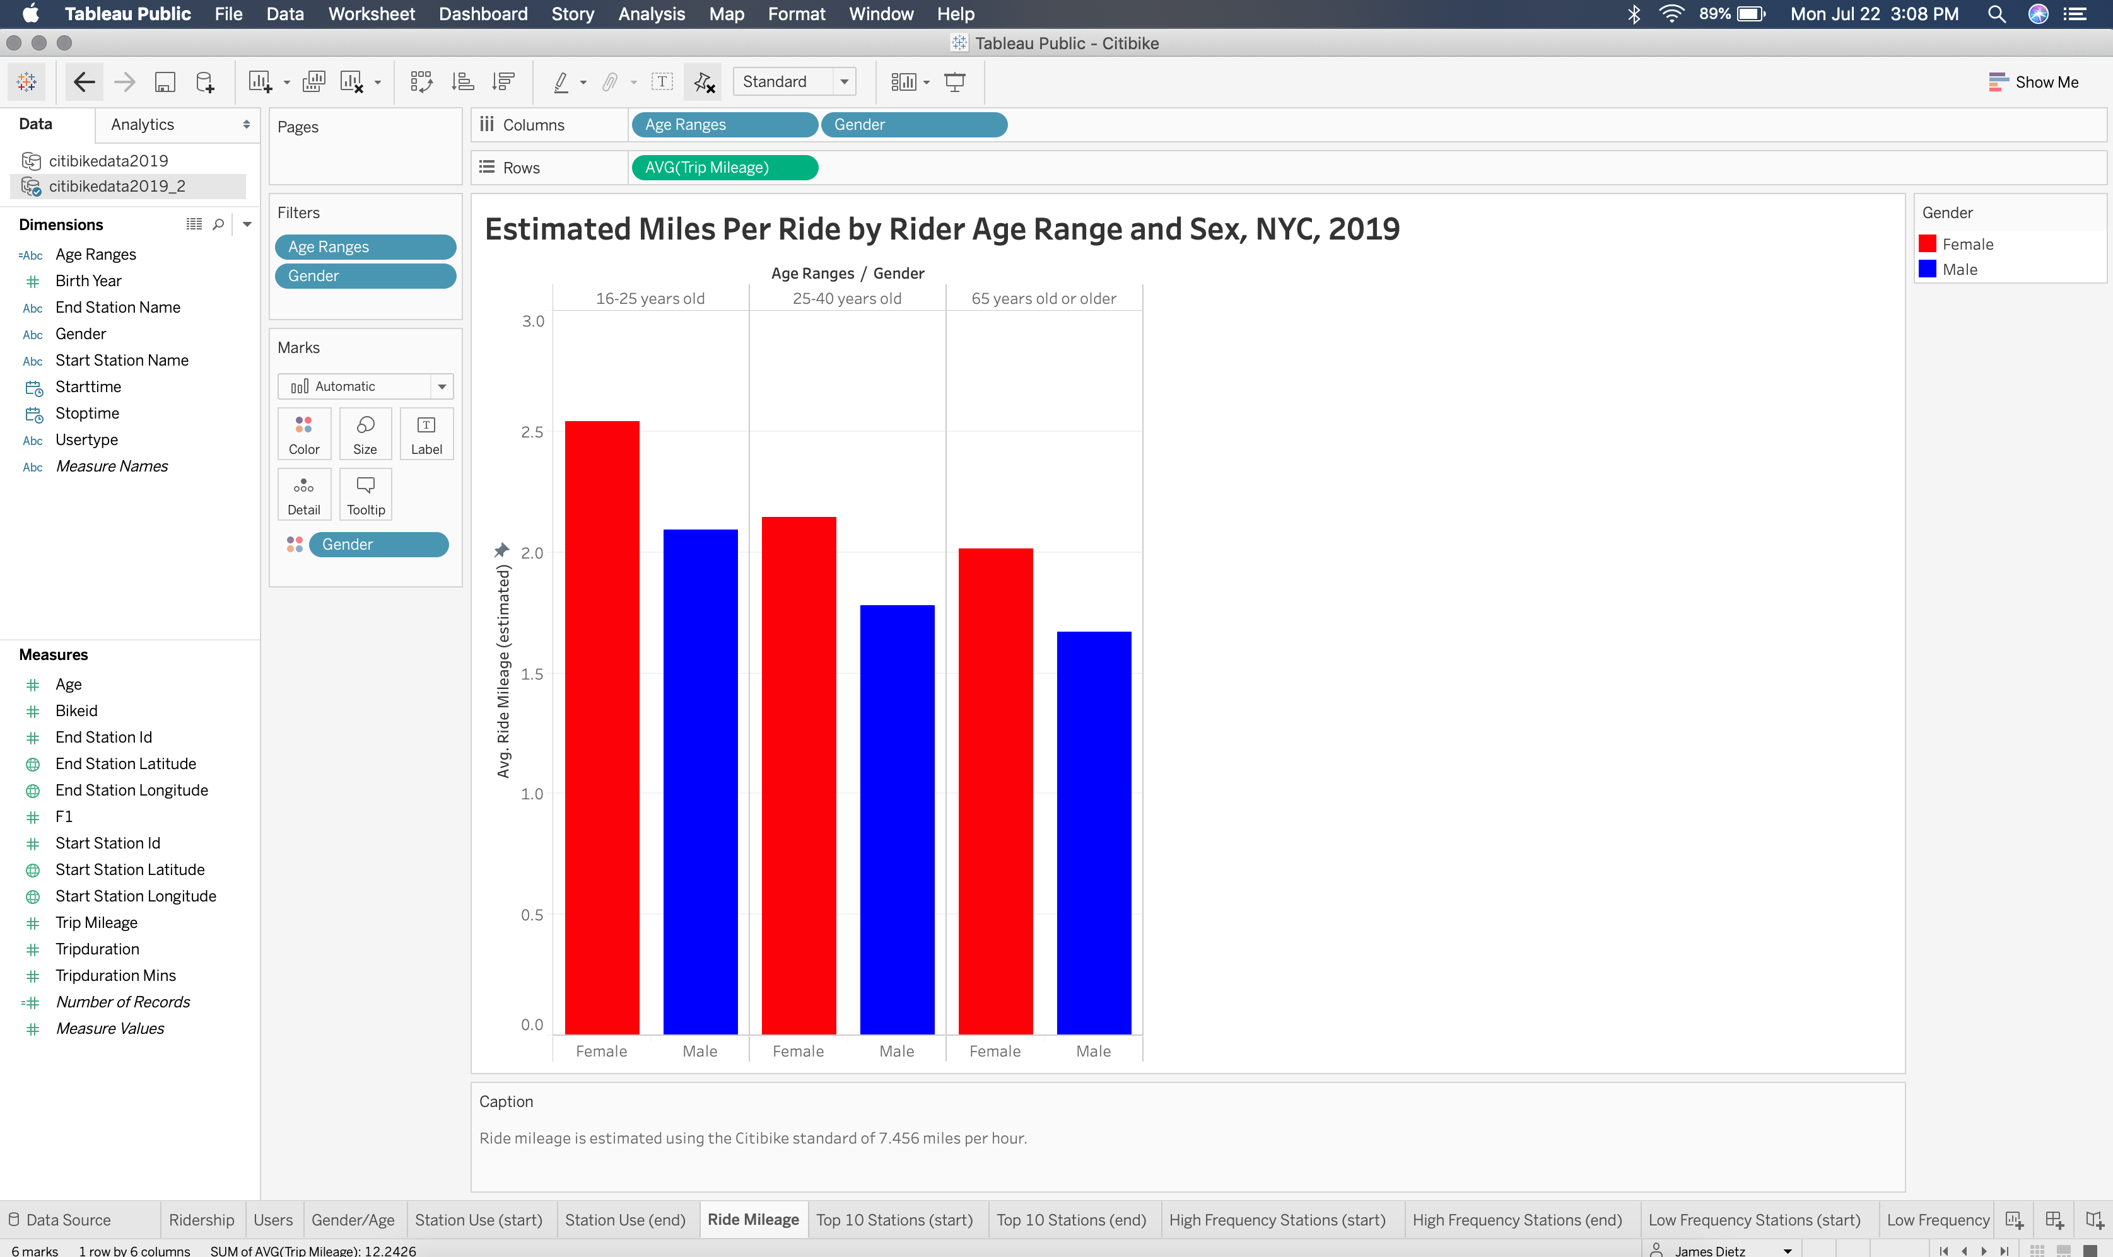

Slide 9
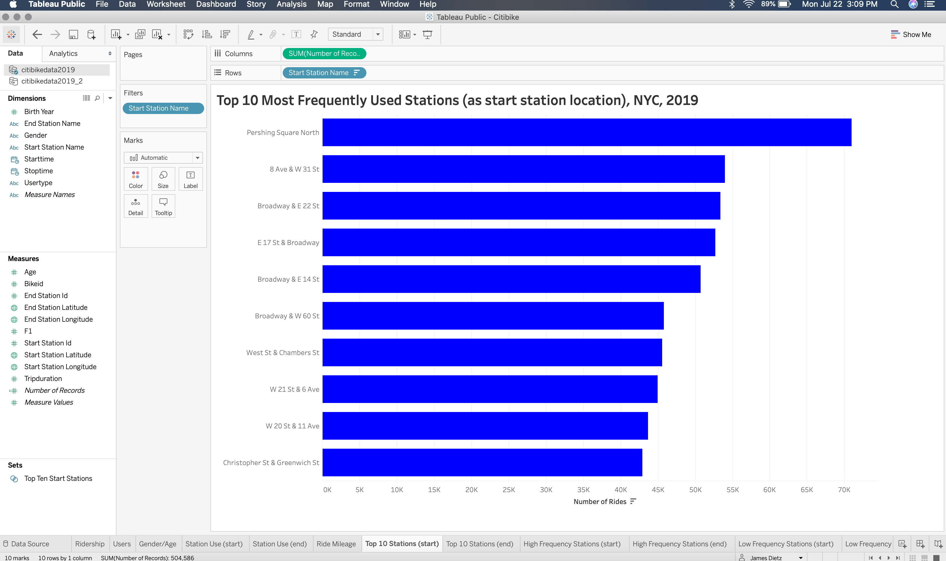

Slide 10
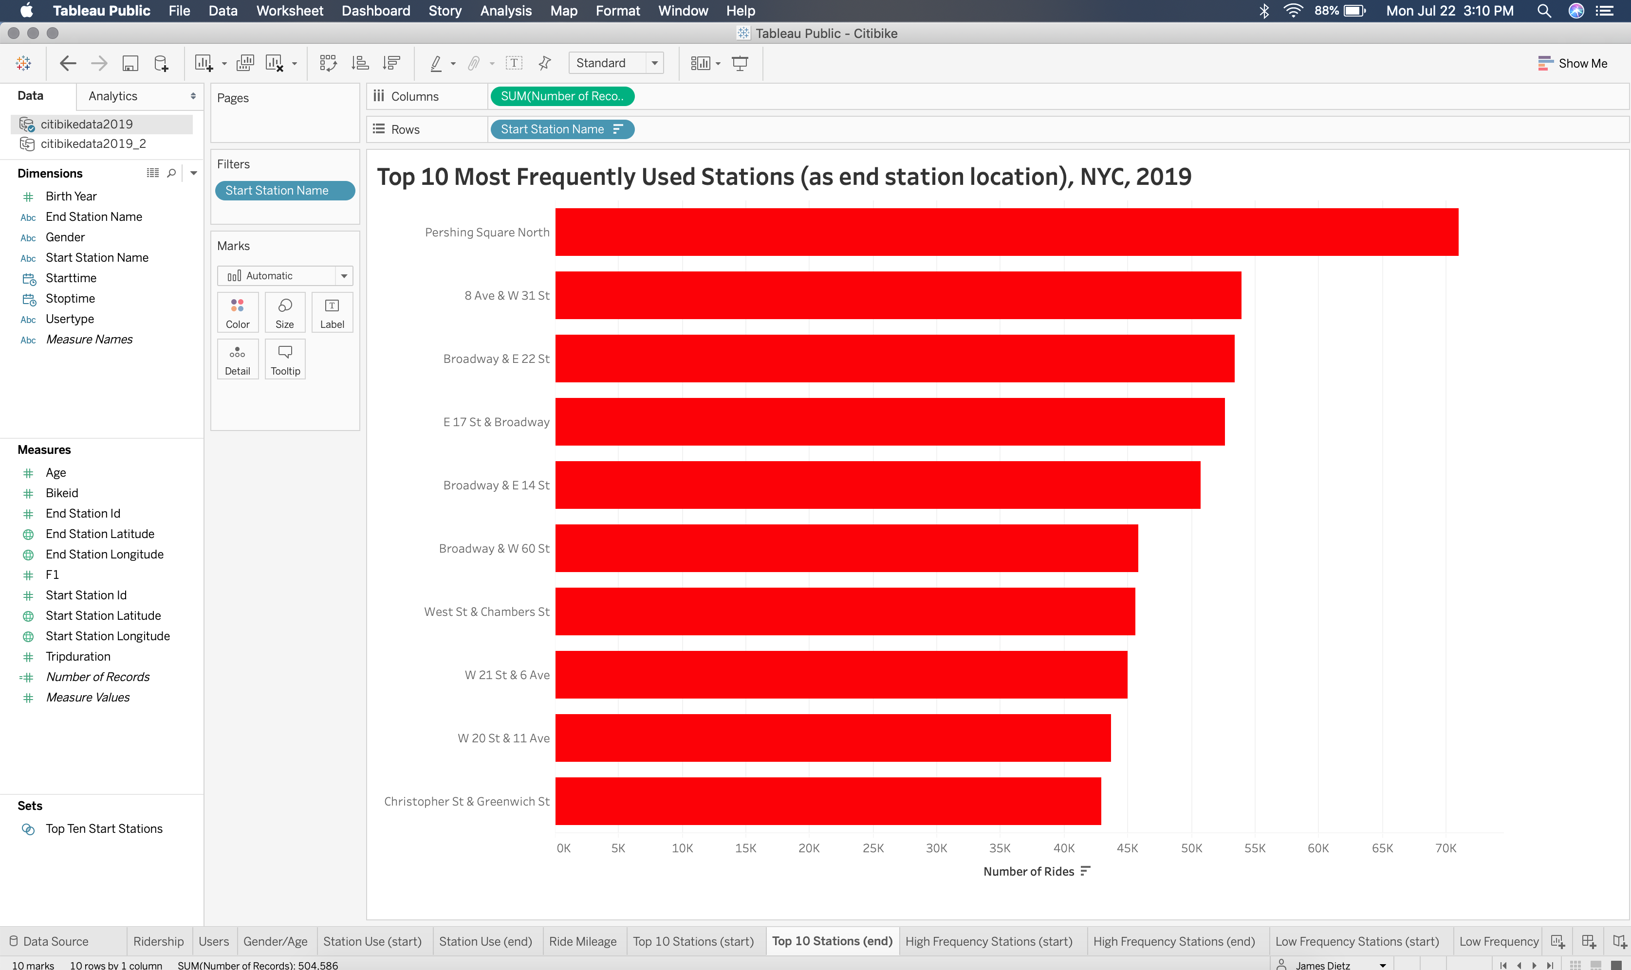

Slide 11
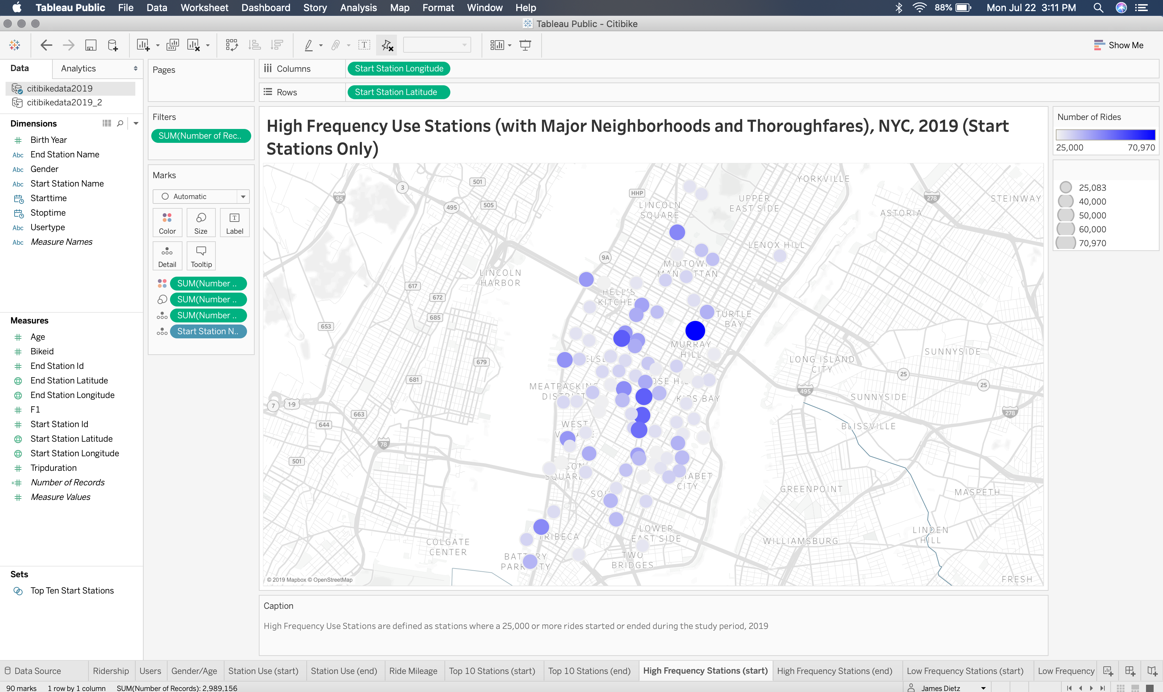

Slide 12
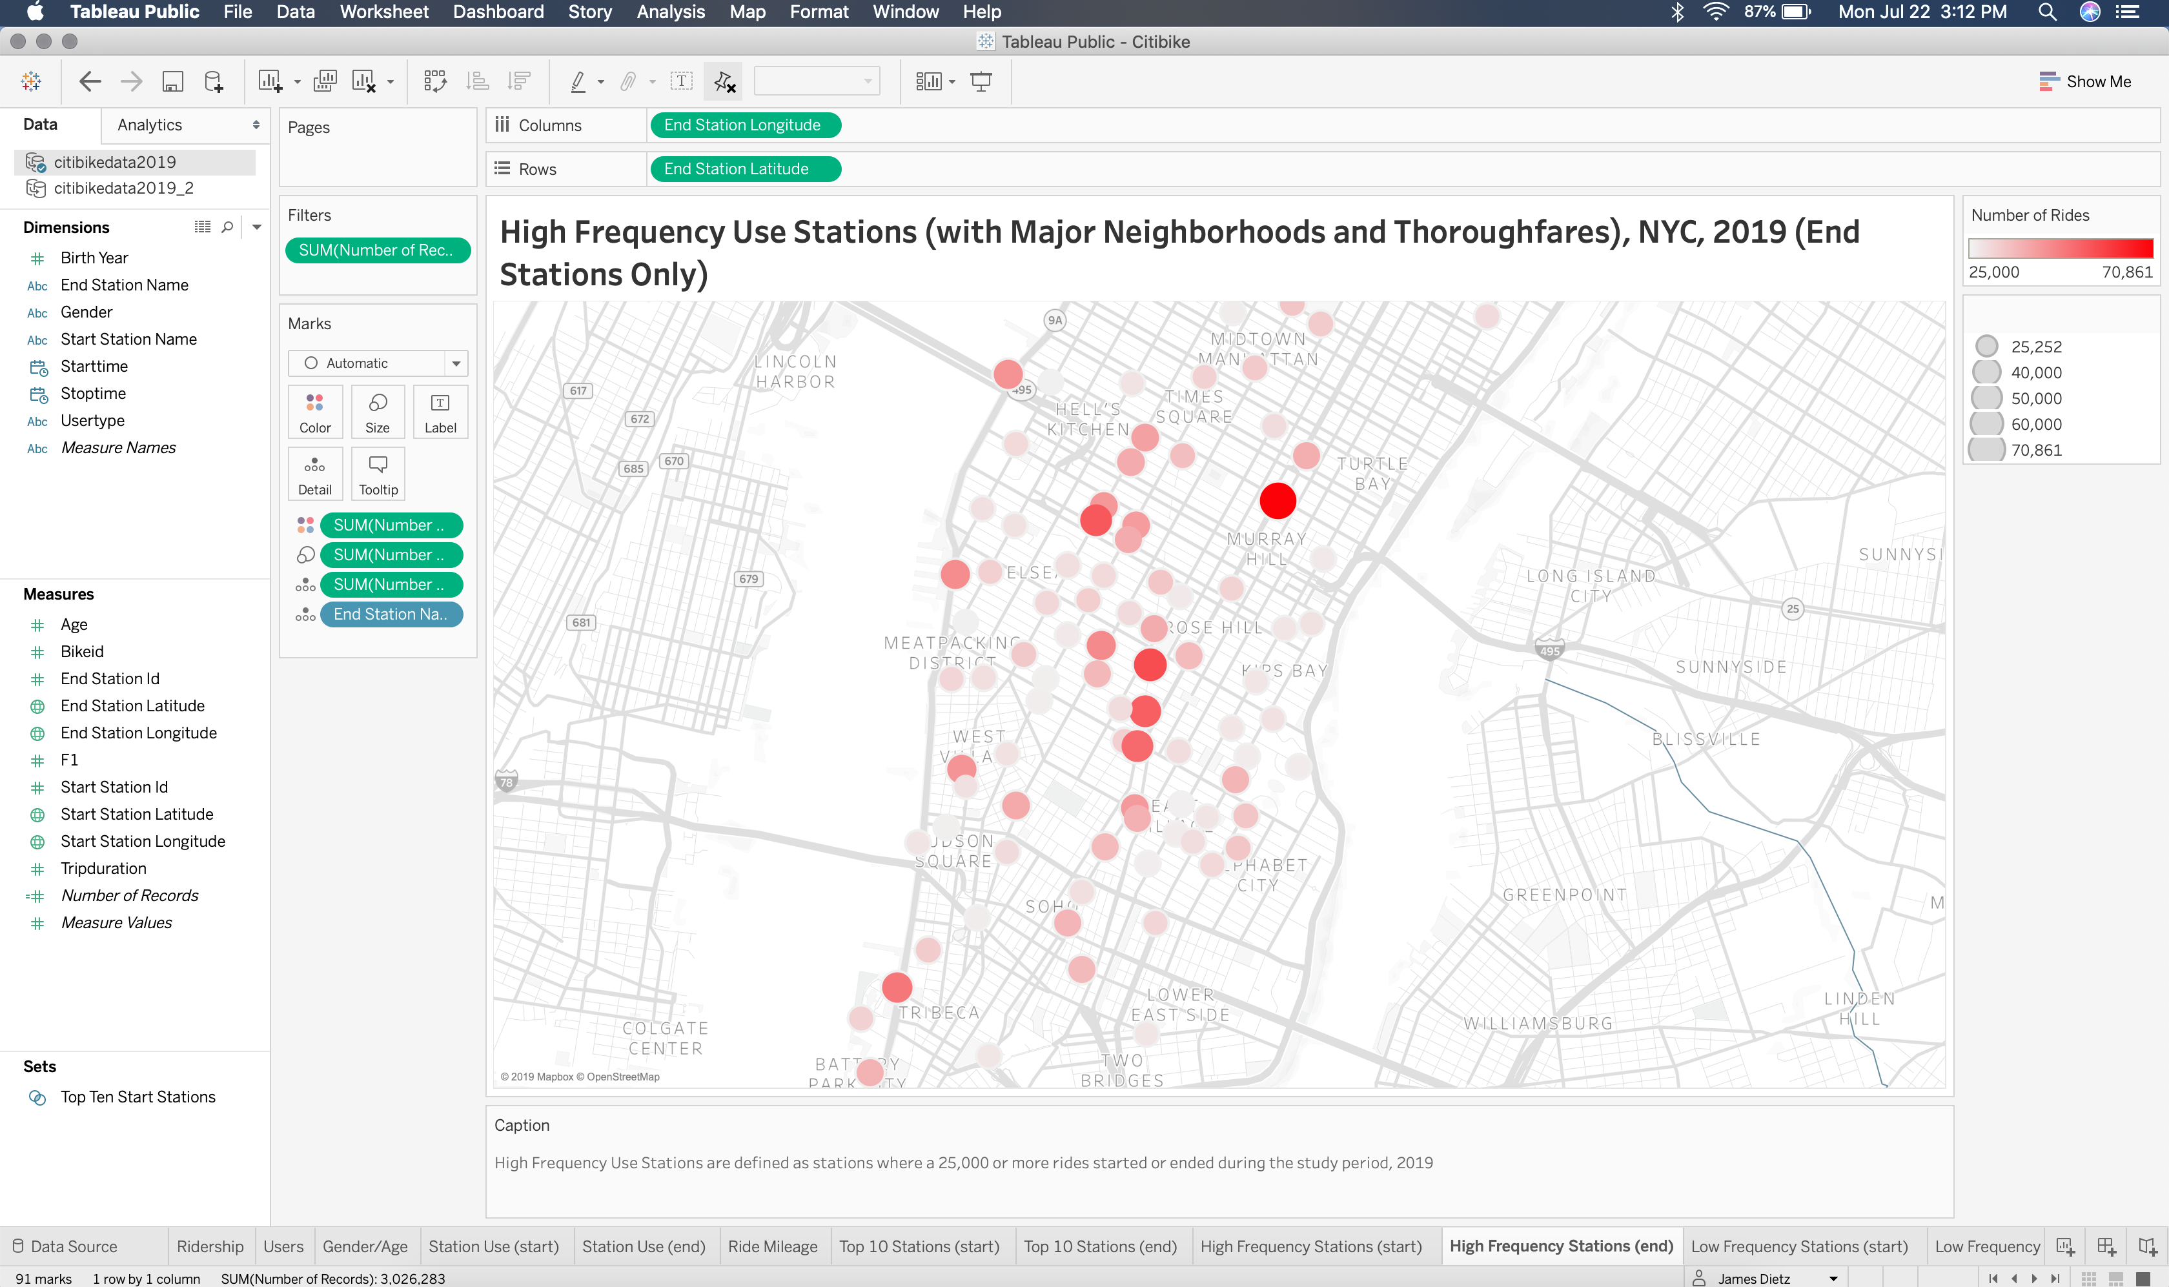

Slide 13
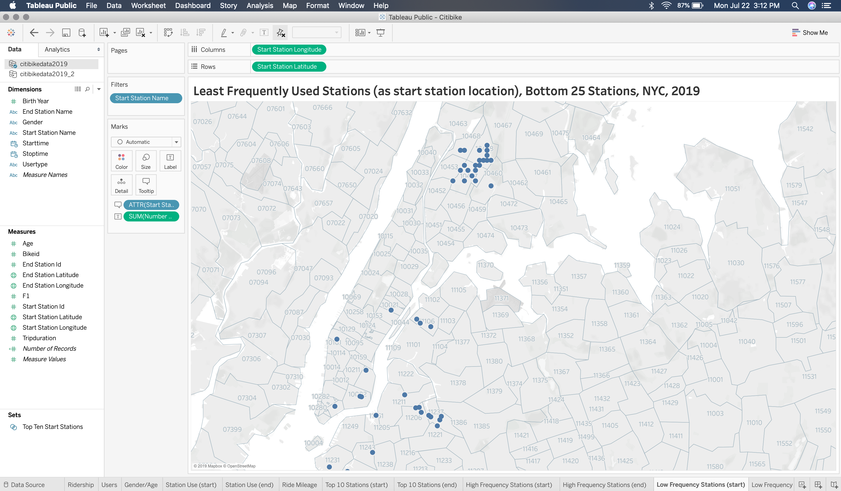

Slide 14
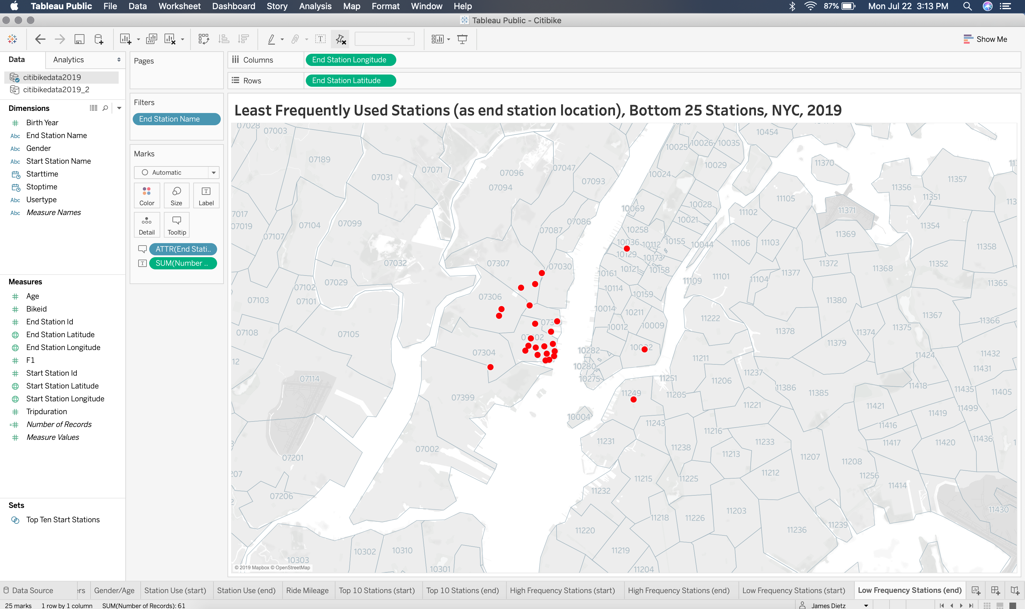

Slide 15
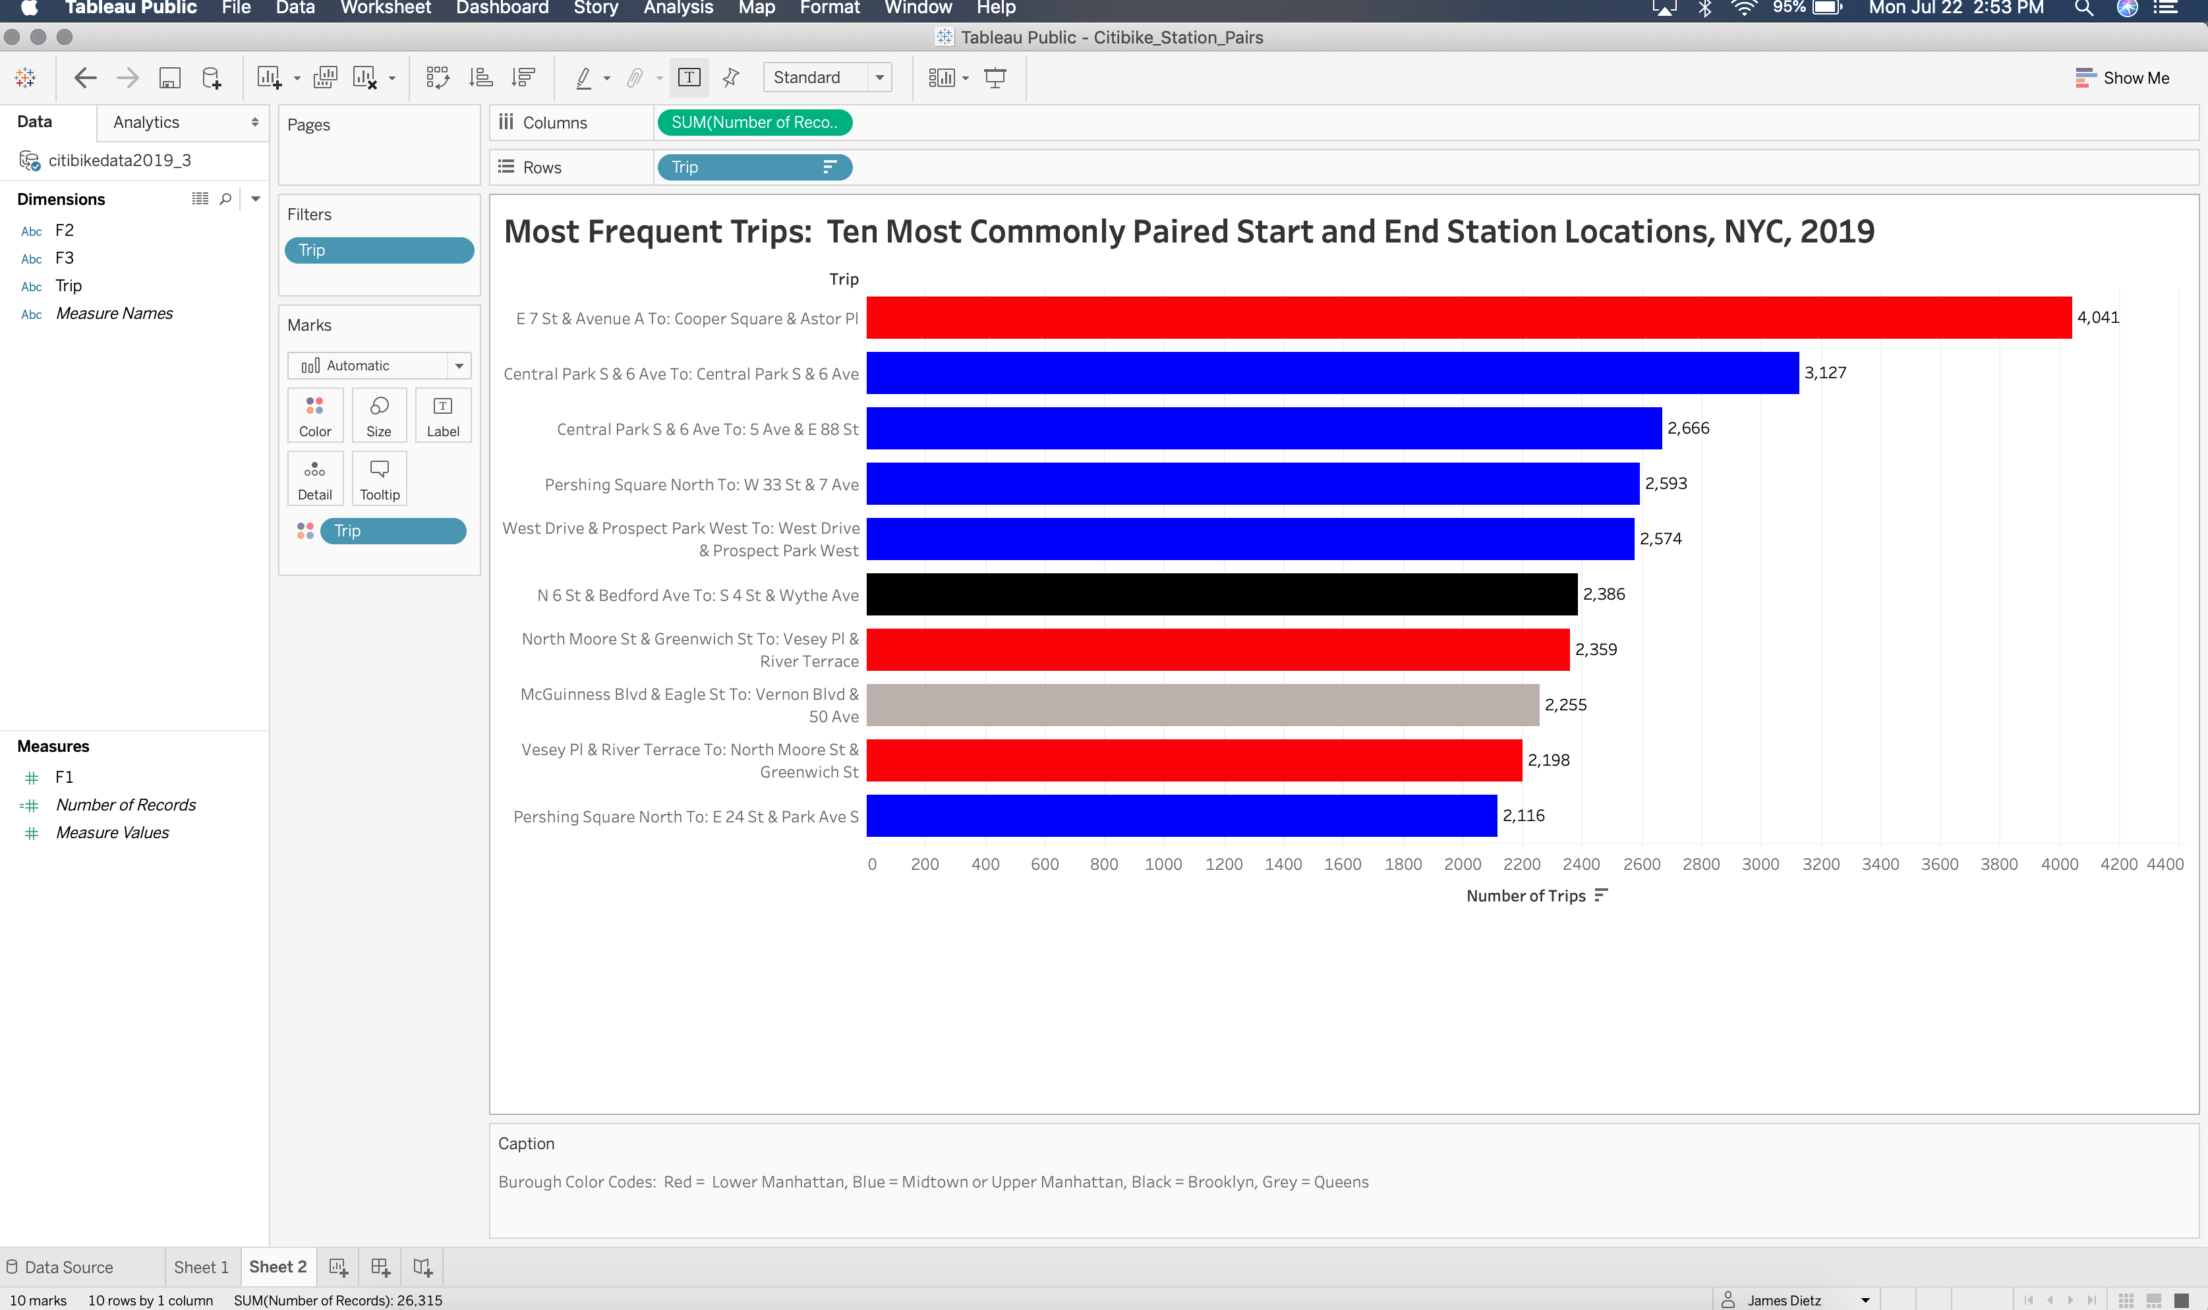

Slide 16
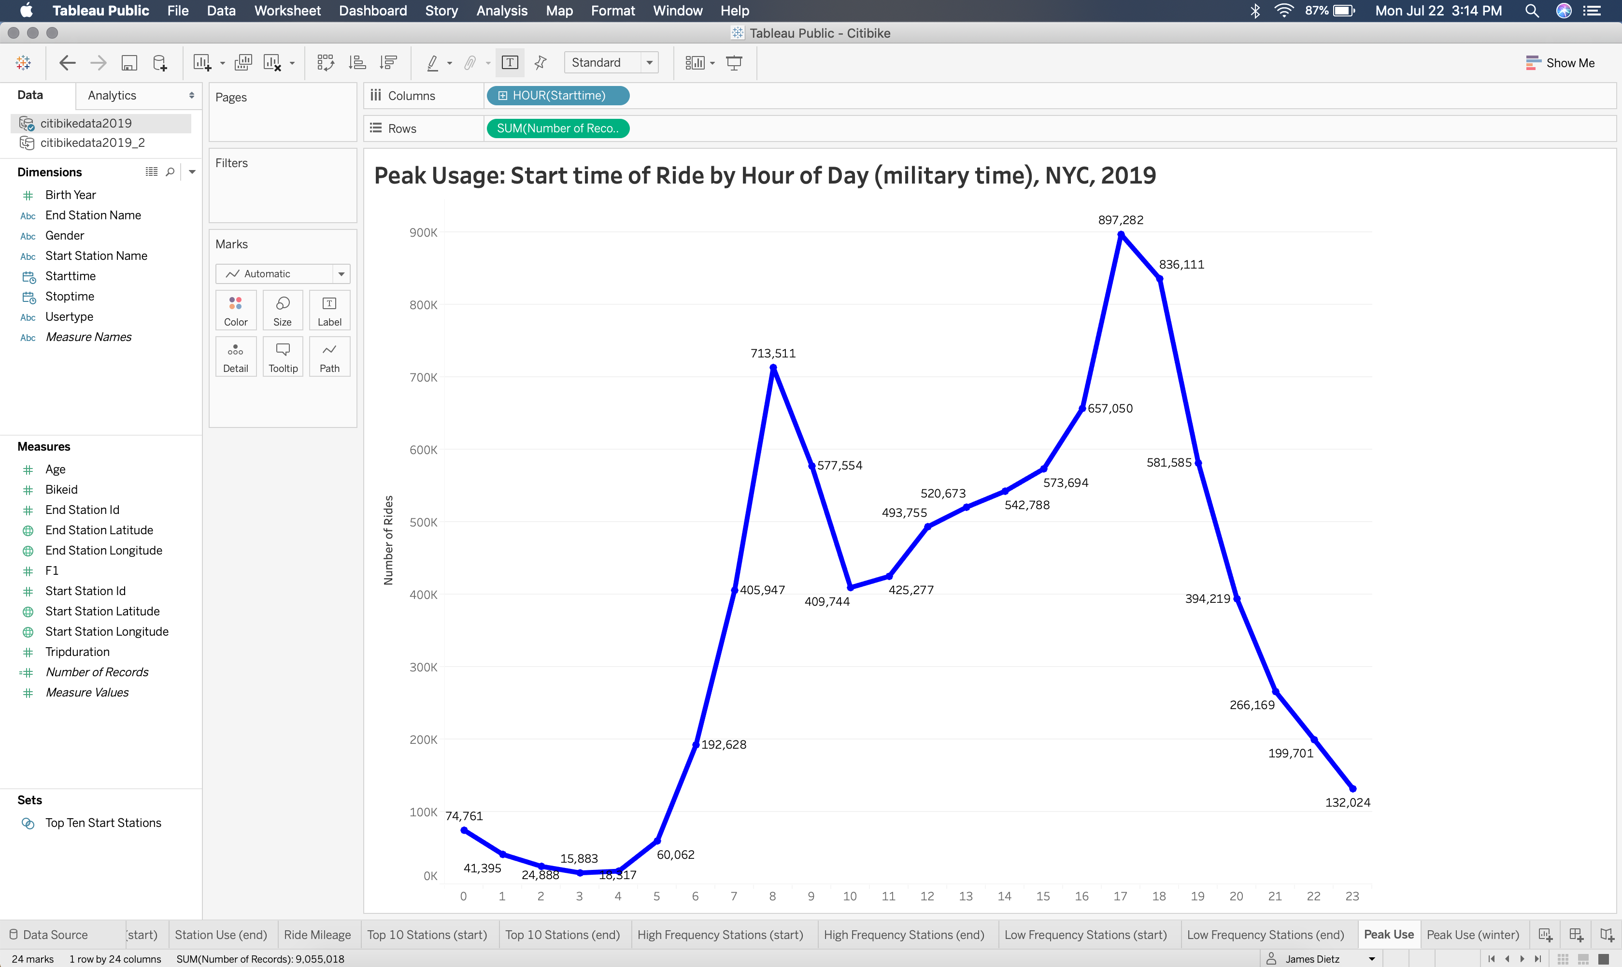

Slide 17
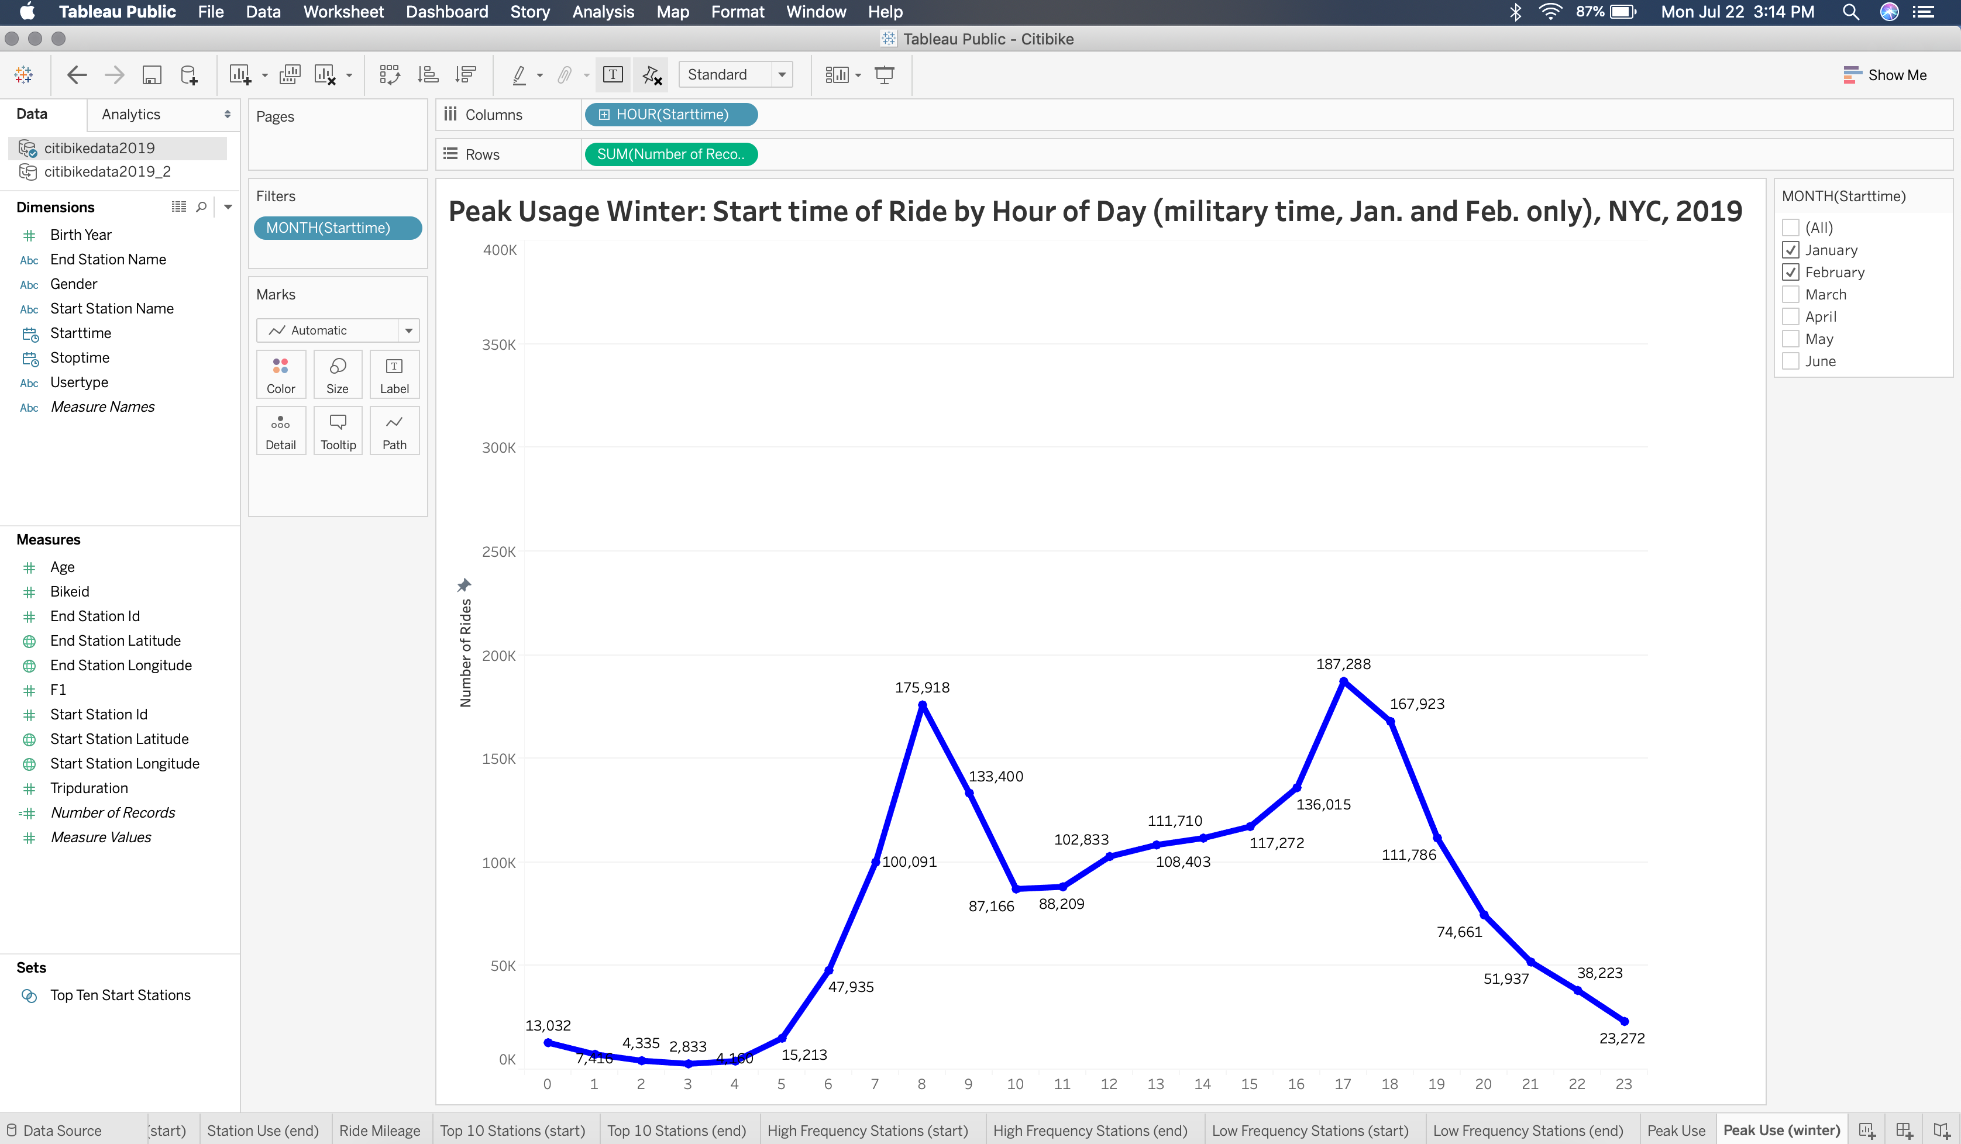

Slide 18
